Slide 1
Social Media & Gaming; Mental Health Impacts on Children
2022
Building Resiliency for Healthy Kids

Slide 2
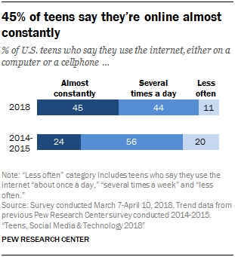
Teen Internet Use Increasing

Slide 3
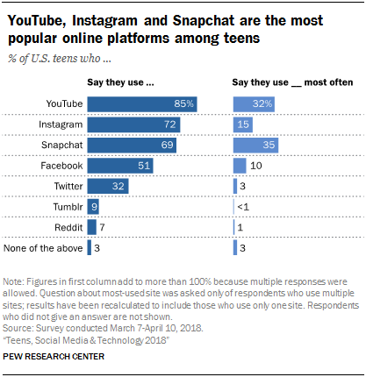
Most Popular Social Media Apps used by Teens - 2018

Slide 4
Cultivating a Virtual Identity
Identity formation is a pivotal part of child and adolescent development.
Apps like Tik Tok encourage youth to develop a virtual identity and “identity management” which can increase anxiety and depression.
Tik Tok provides an even more “ego-centric” experience of engaging with one’s own self rather than an interpersonal connection.
Creation of the “Algorithmized Self” or self branding to be successful on the platform.
(Bhandari & Bimo, 2020)

Slide 5
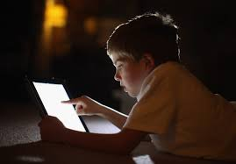
Average time per day online
Teens reported being online an average of 9 hours per day.
Children 8-12 spend an average of 6 hours per day.
(Common Sense Media)

Slide 6
Ambitions of Social Media
Community Building (finding like-minded peers)
Self-Identity
Maintaining Relationships
Empathy, Awareness, and Understanding of others.
Emotional Support

Slide 7
Negative Effects of Social Media
Increased feelings of depression
Overthinking and Rumination
Anxiety
Poor Body Image
Loneliness
FoMO (Fear of Missing Out)
Poor Sleep Quality
Highly Addictive
(Royal Society for Public Health, 2017)

Slide 8
What’s bad about social media?
Most teens:
post photos of themselves online or use their real names on their profiles
reveal their birthdates and interests
post their school name and the town where they live
This can make them easy targets for online predators and others who might mean them harm.
In fact, many teens say they have:
been contacted online by someone they didn't know in a way that made them feel scared or uncomfortable
received online advertising that was inappropriate for their age
lied about their age to get access to websites

Slide 9
The Social Dilemma
Social media is elaborately tracking everything you’re doing online.
Artificial intelligence software creates algorithms to maximize social media usage with targeted content and advertising.
Fake news spreads 6 times faster than true news.
Reduces interpersonal interactions as individuals are more entitled to their own facts.
Preys on the dopamine reward system.
“Comparison is the Thief of Joy” – Teddy Roosevelt
Social media companies, and substance abuse treatment centers, are the only businesses that call their clients “users”.

Slide 10
Affects of Social Media
Snapchat, Facebook, Twitter, and Instagram (Tik Tok) all led to increased feelings of depression, anxiety, poor body image, and loneliness. –Royal Society for Public Health study
Reduced ability to read and interpret social cues. Reduced empathy, self awareness.
Reduced ability to take risks; making new friends, driving, wanting to go to college and leave the home.

Slide 11
Is my child ready for social media?
Answer two questions:
Are you comfortable exposing your child to a particular movie, song, game or website without constantly monitoring or overseeing them?
Are you comfortable answering your child's questions about sex, violence, abuse, self-destructive behavior or materialism that this media exposure might bring up?
If you’ve answered “no” to either of these questions your child is likely not ready for social media.
–Amy Sass, MD Childrens Hospital Colorado

Slide 12
Rating Social Media Sources
Based on the responses of 1,400 teens in UK.
YouTube (most positive)
Twitter
Facebook
Snapchat
Instagram (most negative)
Image focused platforms seem to be worse for mental health.

Slide 13
Why are images the most harmful social media content?
Digitally enhanced/ re-touched images create unrealistic expectations for body image.
Teens comparing themselves to peers’ retouched images rather than celebrities.
Normalize an unrealistic body ideal.
Teens posting best version of themselves.
In a study of 144 teenage girls most were generally unaware that Instagram photos could be manipulated.
The higher photo manipulation correlated with a higher social comparison.
(methods: Body Image State Scale, Iowa-Netherlands Comparison Orientation Measure).
(Journal of Media Psychology, 2018)

Slide 14
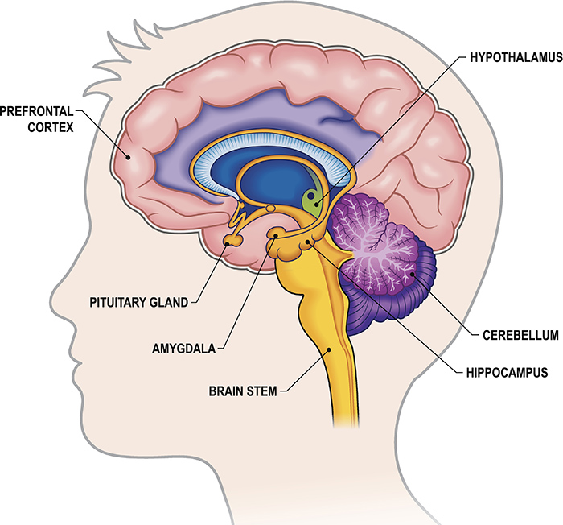
What about gaming?
Gaming provides an escape from real life.
fMRI studies show that the amygdala calms down during gaming. The amygdala governs fear and negative emotion.
The amygdala connects to the hippocampus, the brain’s center of learning and memory, and that avoidance of pain and negative emotion is reinforcing.

Slide 15
Neuroscience of Gaming
When gaming you’re no longer activating your learning circuitry (hippocampus).
The rational mind will say “games are bad for me”, but there is a block from changing behavior because pain is inhibited (amygdala deactivated) and the hippocampus isn’t learning.
This unconscious block occurs in the “reptilian brain”.

Slide 16
DSM-5 Internet Gaming Disorder(unofficial, “condition of further study”)
Repetitive use of Internet-based games, often with other players, that leads to significant issues with functioning. Five of the following criteria must be met within one year:
Preoccupation or obsession with Internet games.
Withdrawal symptoms when not playing internet games.
A build-up of tolerance—more time needs to be spent playing the games.
The person has tried to stop or curb playing Internet games but has failed to do so.
The person has had a loss of interest in other life activities, such as hobbies.
A person has had continued overuse of Internet games even with the knowledge of how much they impact a person’s life.
The person lied to others about his or her Internet game usage.
The person uses Internet games to relieve anxiety or guilt—it’s a way to escape.
The person has lost or put at risk and opportunity or relationship because of Internet games.
8.5% of American youth meet criteria (Gentile & Bailey, 2017)

Slide 17
Symptoms Related to Compulsive Gaming
Related to Obsessive Compulsive Disorder (obsessional thoughts, compulsive acts).
When children are “hooked”, they develop mood swings, irritability, restlessness, and aggressive behavior when they are denied their gaming.
Molecularly very similar to substance abuse addictions.
Characterized by their salience or importance, mood elevation, tolerance, withdrawal, conflict and relapse.

Slide 18
Social Impacts of Online Gaming
Social Displacement- the replacement of offline peers for online.
Inability to develop and maintain close interpersonal relationships.
Poor social skills and recognition of social cues.
(Kowert, Domahidi, Festl, & Quandt, 2014)

Slide 19
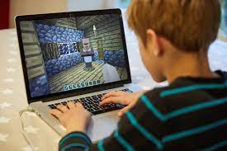
Questions for Young Gamers
Are you preoccupied and spend lot of time thinking about the video games?
• Do you feel symptoms of “withdrawal” like being restless, irritable, moody, angry, anxious or sad when you are denied to play the games?
• Are you developing “tolerance” because you have to play for a longer duration, or play more exciting games, or use more powerful equipment to get the same amount of pleasure as before?
• Do you feel that you should play less but you are unable to do so because you feel “hooked”?
• Have you lost interest or reduced your participation in other social or recreational activities due to gaming?
• Do you continue to play digital games despite knowing its negative consequences?
• Do you play video games to escape from your personal problems or relieve your uncomfortable feelings such as guilt, anxiety, helplessness, and depression?
• Are you at risk to lose your relationships, job, educational achievements, or career opportunities because of video gaming?

Slide 20
Consequences of High Screen Time
Poorer emotional regulation
Impaired capacity of finishing tasks
Lower curiosity
Difficulty making friends
Lower self control
Higher anxiety and depression symptoms
Poor sleep
Risk for myopia (nearsightedness)
(Babic et al., 2017, Blumberg et al., 2008, Van der Schuur et al., 2018)

Slide 21
Setting Appropriate Limits
Parents should feel empowered to make rules around media and gaming, including setting limits.
Supervising media use is recommended.
Agreeing on a set duration prior to use. Setting timers.
Not locating media or gaming in the bedroom.
Parents limiting their own use in the home.

Slide 22
Why Don’t Parents Monitor Teen Social Media Use or Gaming?
Feeling it’s a violation of privacy and trust.
Like “Reading their diary”.
Feels like the removing accountability from teens in navigating social situations.
“I don’t want to know”.
Teens often create secret accounts.
Parents don’t want to limit themselves or see screen time as a way of keeping children occupied.
Guilt about Covid-19 and loss of other activities and social outlets.

Slide 23
Impacts of Limiting Screen Time AAP < 2 hrs per day
Increased attachment to parents/ family
Improved affect and mood
Increased physical activity
Improved academics

Slide 24
Engage Your Family
Engage your teen in meaningful conversation about internet use
Talk about being a good digital citizen.
Validate your teen's reality and their need to be connected
Engage your child in drafting the rules for the family:
-guidelines for use
-consequences for breaking those rules
Model appropriate use of technology:
-minimize texting
-don't use cell phone/laptop at meals
-don't use cell phone in the car

Slide 25
Screen Time Tips
Don’t make screens the reward, or the consequence.
Makes it more desirable, causes child to overvalue.
Point out/ ask questions about changes in mood, low frustration tolerance, or changes in social activity you notice in your child.
Encourage other activities and model doing them. Playing outside, doing crafts, cooking with your kids, challenging them to a game, building a model, lego set, etc..
Be prepared for difficult conversations when your kids stumble onto inappropriate content. If you don’t answer those questions the internet will.
Encourage face-to-face interaction, even if its virtual. (FaceTime, Zoom).

